Slide 1
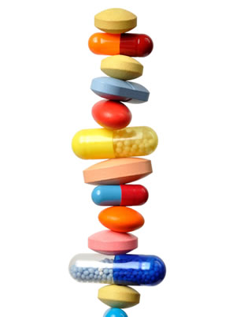
THERAPEUTIC DRUG MONITORING
Dr. Priti Patel

Slide 2
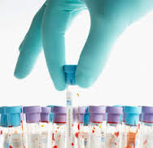
CONTENTS
What is TDM
Need of TDM
Indications
Factors affecting
Various classes of DRUGS
Use of pharmacokinetic studies
TDM technologies

Slide 3
What is “Therapeutic drug monitoring”
Therapeutic drug monitoring is a system of quality assurance of a drug management system ,
aiming that the right drug
is given to the right patient
in the right dose in order to
obtain the right effect.
Therapeutic Drug Monitoring is measurement of the plasma concentration level of a drug and the coordination of this serum level with a serum therapeutic range.

Slide 4
TDM: is defined as the use of drug concentrations in body fluids as an aid to management of patients receiving drug therapy for the cure, alleviation or prevention of disease.
It is a tool that can guide clinicians to provide effective and safe drug therapy in the individual patient.

Slide 5
Concepts of TDM
Therapeutic response correlates with blood concentration
2. There exists an optimum therapeutic range within which the majority of patients experience maximum benefit with minimum toxic effect.
3. By adjusting the dose &/or timing of administration on the basis of plasma concentration, optimum drug therapeutic range can be attained and maintained

Slide 6
When is TDM not useful?
When an active metabolite contributes to the effect
Toxic effects are idiosyncratic & not related to plasma level
Action of drug is irreversible, the action will occur even though the concentration has fallen to zero
Biologic effect can easily be monitored
e.g. oral antidiabetic agent
When the concentration at the site of action is unrelated to plasma concentration

Slide 7
OBJECTIVE
To attain rapid and safe concentration of drug in plasma within the desired therapeutic range in order to provide the safest approach to optimal drug therapy.
To coordinate clinical pharmacology, pathology, chemistry, toxicology, analytical chemistry and medicine.
To remove empirical trial and error approach.

Slide 8
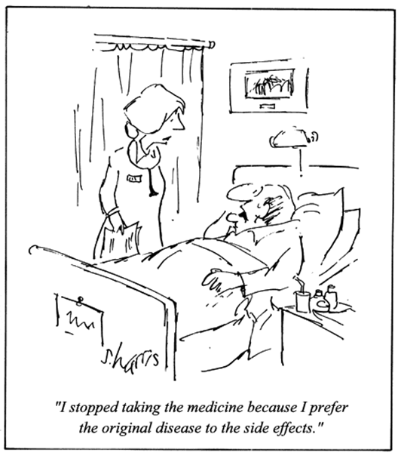
WHY TDM

Slide 9
Why therapeutic drug monitoring..
Certain drugs have a narrow therapeutic range
In concentrations above the upper limit of the range, the drug can be toxic.
In concentrations below the lower limit of the range, the drug can be ineffective.
Not all patients have the same response at similar doses.

Slide 10
Indications for TDM Testing.
Drug efficacy difficult to establish clinically (Phenytoin)
Narrow TI: digoxin
Conc. related therapeutic and adverse effects e.g. phenytoin: ataxia, vertigo, drowsiness
Suspected toxicity
Inadequate therapeutic response
Doubtful patients compliance.
Inter individual variations in metabolism.

Slide 11
Pharmacokinetic variability e.g. aspirin, digoxin.
Hepatic and renal diseases: aminoglycosside
Multiple drug therapy and drug interaction,
Probenicid increases level of penicillin,
quinidine decreases digoxin clearance
Saturation kinetics: omeprazole : P450 2C19
Manifestations of toxicity and disease state are similar (Theophylline)(xanthines : COPD airway opening)
Difficult to recognized toxicity clinically: cyclosporin, Seizures

Slide 12
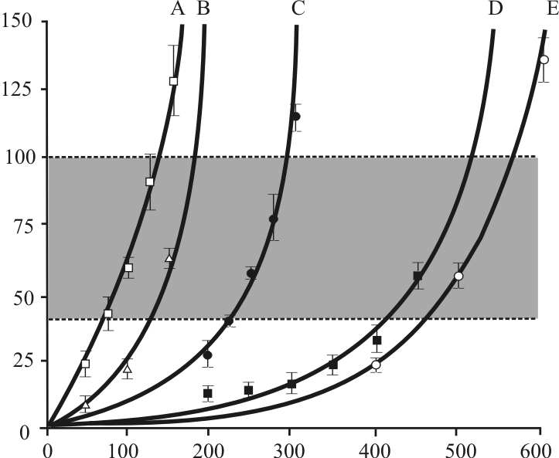
What are indications of TDM
Drugs for which relationship between dose and plasma concentration is unpredictable, e.g Phenytoin

Slide 13
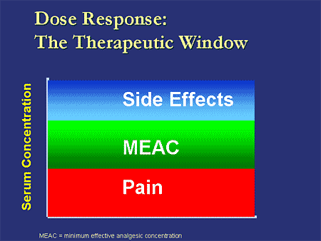
Drugs with a narrow therapeutic window:-measurement of plasma concentrations of such drugs will allow dosage alterations to be made in order to produce optimal therapeutic effect or to avoid toxic effects.

Slide 14
Drugs with steep dose response curve for which a small increase in dose can result in a marked increase in desired or undesired response e.g. theophylline.

Slide 15
To evaluate compliance of patient
Drugs for which there is difficulty in measuring or interpreting the clinical evidence of therapeutic or toxic effects:- Nausea & vomiting occur in both digitalis toxicity & congestive heart failure.
For diagnosis of suspected toxicity & Determining drug abuse

Slide 16
Renal disease: Alter the relationship between dose & the plasma concentration. Important in case of digoxin, lithium & aminoglycoside antibiotics.
When another drug alter the relationship between dose & plasma concentration e.g. plasma concentration of lithium is increased by thiazide.

Slide 17
TDM : Not Suitable for
Drugs that are used for treating diseases of which their clinical end points can easily be monitored, e.g., BP, HR, cardiac rhythm, blood sugar, blood cholesterol and triglycerides, urine volume, body temperature, pain, headache, etc.
Drugs whose serum concentrations do not correlate with therapeutic or toxic effects.
Drugs with less complicated pharmacokinetics.
Drugs having wide therapeutic index
Hit and run drugs: omeprazole, MAO inhibitors

Slide 18
TDM : CLINICAL SIGNIFICANCE
Maximizes efficacy
Avoids toxicity
Identifies therapeutic failure
Non compliance, subtherapeutic dose
Facilitates adjustment of dosage
New dose = Old dose X Desired C_{ss}/Old C_{ss}
Facilitates the therapeutic effect of drug by achieving target drug concentration
Identify poisoning, drug toxicity and drug abuse

Slide 19
Some Concepts to be Revised
Amount of drug present in the
bloodstream
Bioavailability
Clearance
Half-Life
Steady state
Concentration
Volume of blood cleared off of a
drug per unit of time
Time required for drug concentration in
the blood to be reduced 50%
Drug available= drug elimination

Slide 20
Dose of drug that should be administered
to bring drug conc in the blood
Loading dose
Maintenance
dose
Dosing interval
Trough
Amount of drug to maintain
steady state conc
Amount of time consecutive doses
of a regularly administered drug
Lowest conc of a drug within
a dosing interval

Slide 21
Peak concentration
Volume of Distribution
Highest drug concentration within a dosing interval
Drug in body/ Plasma concentration

Slide 22
Therapeutic range/ therapeutic window
The therapeutic range/ therapeutic window is the concentration range of drug in plasma where the drug has been shown to be efficacious without causing toxic effects in most people.

Slide 23
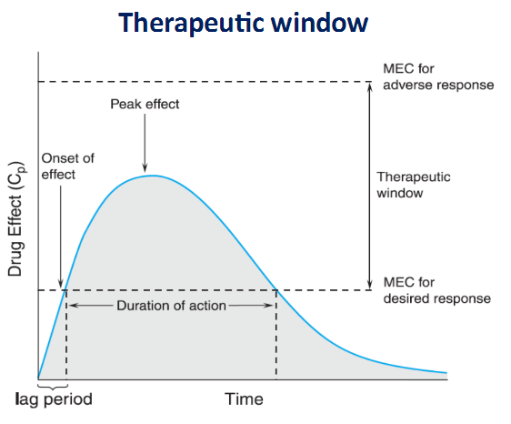

Slide 24
Factors that Affect Results
Many factors contribute to the production of an accurate and meaningful drug level measurement:
Pharmacokinetics
Pharmacodynamics
Dose
Sampling time
Testing methodology
Genetic polymorphisms

Slide 25
Major Sources of Pharmacokinetic Variability
Patient Compliance
Age – neonates, children, elderly
Physiology – gender, pregnancy
Disease – hepatic, renal, cardiovascular, respiratory
Drug-to-drug interactions
Environmental influences

Slide 26
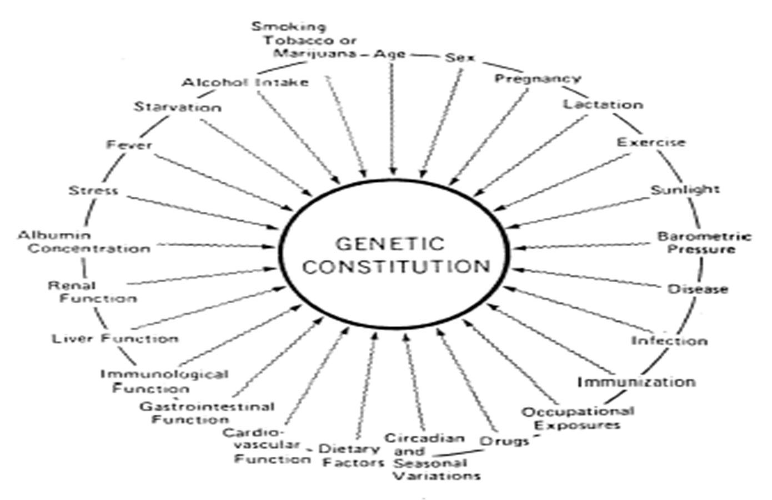
Pharmacokinetic Variability

Slide 27
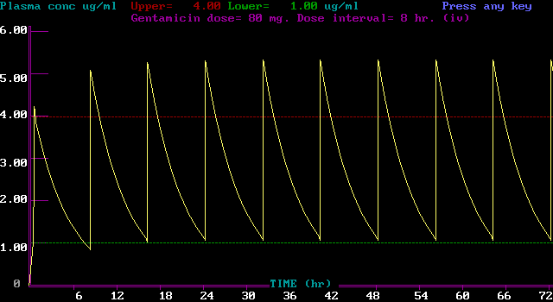
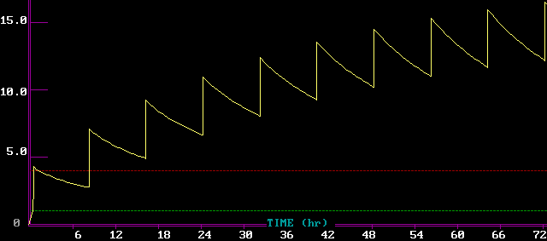
A comparative study for Gentamycin metabolism (a) Healthy organs (b) In case of Renal Failure

Slide 28
Factors that Affect Interpretation
Protein Binding
TDM assays typically require serum or plasma and usually measure both the bound and unbound drug.
This is not an issue unless the patient’s binding capacity is altered due to disease-state, drug interaction, or non-linear binding.
In such cases, the effect of the protein binding needs to be taken into consideration when interpreting results

Slide 29
Active Metabolites
Many therapeutic drug metabolites, though not measured, contribute to a drug’s therapeutic response. For example, primidone treatment is monitored by measuring phenobarbitone, an active metabolite.
Steady State
Steady state is defined as the point at which drug intake and elimination reach an equilibrium, Steady state is reached after 5-6 half lives of the drug. The goal of therapeutic drug monitoring is to optimize the drug dose so the patient’s drug concentrations remain within the therapeutic range for the drug.

Slide 30
Relationship between daily dose of phenytoin and resulting steady-state serum level in five patients on several different doses of drug.
Phenytoin dose (mg/day)

Slide 31
Turn-around Time:
Turn-around time is also important to ensure that the physician has time to evaluate the result before the patient is scheduled to receive his next dose. For most therapeutic drugs this is not an issue, as assays for the most commonly tested analytes are available on several fully automated analyzers. However, for drugs without commercially available assays, highly specialized chromatographic and ultra-filtration assays are used.

Slide 32
There are several classes of drugs commonly monitored to ensure correct blood concentration:
Antiepileptics
Antiarrythmics
Antibiotics
Antineoplastics
Antimanics
Bronchodilators
Immunosuppressives

Slide 33
Examples of drugs requiring TDM
Digoxin: 0.8 -2 µcg/L
Theophylline:10-20 mg/L
Gentamicin: 2-12 mg/L
Lithium: 0.8-1.2 mmol/L
Phenytoin: 10-20 mg/L
Carbamazepine: 4-12 mg/L
Ciclosporin: 100-200 ng/Ml
Vancomycin
Procainamide

Slide 34
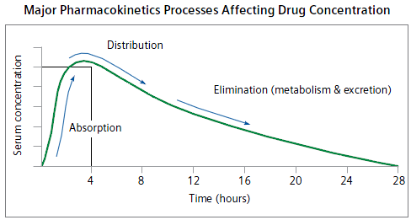
Pharmacokinetics is the study of what the body does to a drug after administration. It is divided into four categories: Absorption, Distribution, Metabolism and Excretion.

Slide 35
Absorption
Absorption refers to the ability and process of a dosage reaching the bloodstream. There are different routes of drug administration. The most common are:
Oral
Intramuscular
Subcutaneous
Rectal
Transdermal
Intravenous
The rate of absorption and extent of absorption are dependent on various factors such as:
Drug formulation.
Dose (or loading dose).
Route of administration.
Frequency of Administration.

Slide 36
Distribution
The volume in which the drug is distributed is a product of the drug’s dose divided by the plasma concentration.
(Vd) = dose/plasma concentration
The distribution phase represents the early period in the dose/time curve when the drug is being circulated in the blood throughout the body and into the body fluids, organs and tissues. Vd is directly related to the half-life of the drug. A drug with a large Vd, gives similar clearance rates, have a longer half-life and remain in the body longer.

Slide 37
Metabolism
Metabolism occurs in the liver, and also in the GI tract. Metabolism is the process in which the body breaks down and converts the drug into active chemical substances.
In addition, drug metabolites can be either protein bound (inactive) or free (active). The drug dosage will depend on how the drug metabolizes.
Factors that impact drug metabolism include genetics, environment, nutrition, and age.

Slide 38
Excretion
Drug excretion from the body occurs through the kidneys, or fluids excreted through the lungs, GI or skin. Renal dysfunction reduces drug clearance and may contribute to drug accumulation and increased risk of adverse drug effects.

Slide 39
Use of Pharmacokinetic Studies
Pharmacokinetic studies are performed to examine Absorption, Distribution, Metabolism and Excretion of a drug.
Therapeutic Drug Monitoring and pharmacokinetic studies help the physician provide optimum care by:
Helping the physician initiate therapy to achieve the maximum therapeutic effect for the patient in the shortest amount of time
Minimizing the risk of drug toxicity
Ensuring drug side effects are controlled and minimized

Slide 40
Help in determination and evaluation of loading dose. The loading dose is a large amount of drug which is administered over a short period of time to quickly move the patient’s serum drug concentration toward a level that will achieve desired patient response.
Another dosing is needed to maintain the patient’s serum drug concentration. The maintenance dose is the amount of the drug and the dose frequency needed to achieve a steady state at the desired therapeutic concentration.

Slide 41
Therapy is achieved when the desired effect is attained because the required concentration has been reached. That concentration would set the lower limit of utility of the drug, called the Minimum Effective Concentration (MEC).
At higher concentrations, toxic effects are seen. That concentration is called the Maximum Therapeutic Concentration or Minimum Toxic Concentration (MTC).
Patient studies have generated upper (MTC) and lower (MEC) plasma concentration ranges that are deemed safe and effective in treating disease. These concentrations are known as the “Therapeutic range” for the drug.

Slide 42
TDM Technologies
HPLC: High Pressure Liquid Chromatography is a common analytical method used to measure therapeutic drug levels prior to the advent of immunoassays.
GC/MS: Gas-liquid chromatography is a separation method using very high temperatures to cause sample vaporization. In mass spectrophotometry the vaporized fractions are passed through an electrical field. The molecules can be separated on the basis of molecular weight. The pattern of separation is unique to each drug and therefore establishes a “fingerprint” for identification.

Slide 43
LC/MS (Liquid Chromatography Mass Spectrometry):
RIA: Not commonly used any longer due to waste disposal issues, RIA or Radioimmunometric assays, use radioactivity to detect the presence of the analyte. In RIA, the sample is incubated with an antibody and a radio-labeled drug. The amount of radioactivity measured is compared to the radioactivity present in known standards which are included in each run. Results are quantitative.
PETINIA: An immunoturbidimetric method that is used today for TDM testing is PETINIA or Particle Enhanced Turbidimetric Inhibition Immunoassay. This method uses the creation of light scattering particles to measure drug levels.

Slide 44
EIA: EIA or enzyme immunoassay. EIA uses a non-radioactive enzyme label. Most of the drug testing today is performed using homogeneous EIA techniques. This refers to the fact that the assays are performed in a single step, i.e. only one antibody is used in the procedure. Therefore, the turnaround time for testing is reduced.
EMIT: The EMIT (Enzyme Multiplied Immunoassay Technique).
The EMIT technology is based on competition for the target analyte antibody binding sites.
FPIA: Fluorescence Polarization Immunoassay. This method uses
a fluorescent molecule as the label instead of an enzyme, making it more sensitive.

Slide 45
Chemiluminescence: This is a chemical reaction that emits energy in the form of light. When used in combination with immunoassay technology, the light produced by the reaction indicates the amount of analyte in a sample. The most common chemiluminescent assay methods are either enzyme-amplified or direct chemiluminescent measurements.
ACMIA: Affinity Chrome-Mediated Immunoassay. ACMIA is a technique to measure drug concentrations in which free and drug-bound antibody-enzyme conjugates are separated using magnetic (chrome) particles.

Slide 46
CEDIA: Cloned Enzyme Donor Immunoassay. CEDIA employs a recombinant DNA technology.

Slide 47
ADVANTAGES
Side effect monitoring
Short hospital stay
Better disease control
Dose adjustment
Doses guideline
Individualized dose requirement
Usefulness to clinical pharmacist

Slide 48
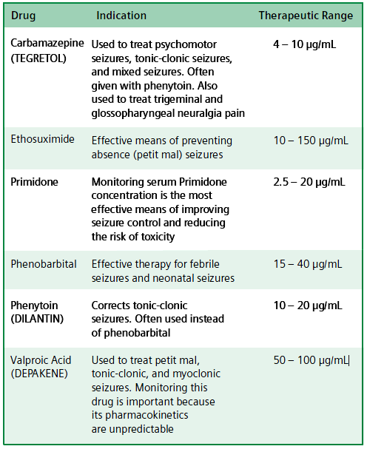
Antiepileptics

Slide 49
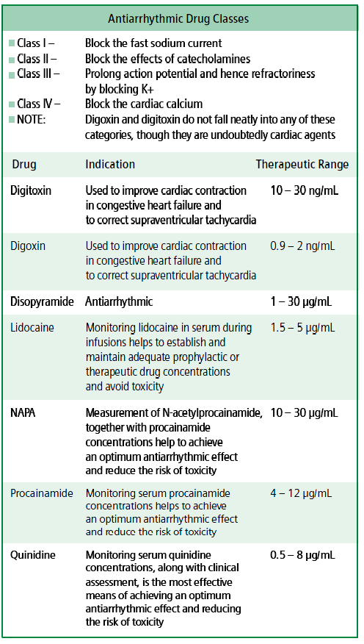
Antiarrythmics

Slide 50
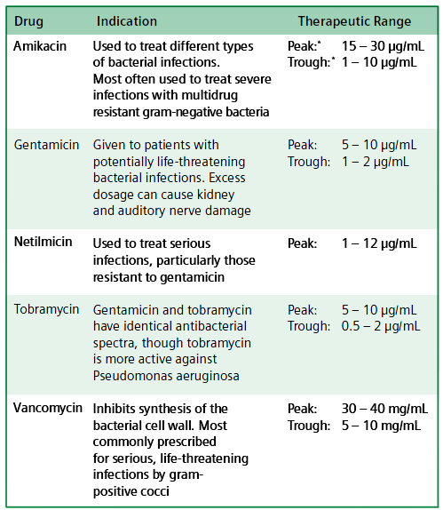
Antibiotics

Slide 51

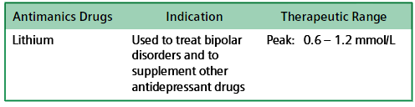
Antineoplastics
Antimanics

Slide 52
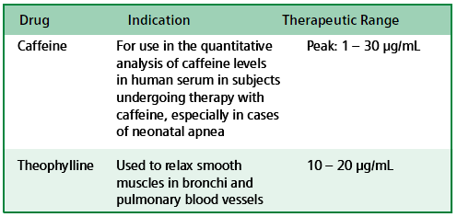
Bronchodilators

Slide 53
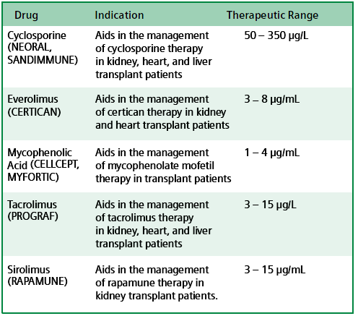
Immunosuppressives

Slide 54
CONCLUSION
TDM is required for effective patient care management
It leads to optimizing pharmacological therapy
Decreased incidence of drug/ drug related toxicity and decreased disease exacerbation
Reduced hospital stay
Avoidance of unnecessary medication
Decreased side effects
It is reliable, valuable and efficient tool of patients compliance and management of therapy in patients receiving complex co medication or suffering from other diseases.

Slide 55
THANK YOU…..!!!!!!!!

